Slide 1


Churn Prediction, Assignment 1, Abstraction

Slide 2
Churn Prediction, Data Description & Datatypes
Feature Name | Description | Data Type
customerID | Customer ID | categorical
gender | Whether the customer is a male or a female | categorical
SeniorCitizen | Whether the customer is a senior citizen or not (1, 0) | numeric, int
Partner | Whether the customer has a partner or not (Yes, No) | categorical
Dependents | Whether the customer has dependents or not (Yes, No) | categorical
tenure | Number of months the customer has stayed with the company | numeric, int
PhoneService | Whether the customer has a phone service or not (Yes, No) | categorical
MultipleLines | Whether the customer has multiple lines or not (Yes, No, No phone service) | categorical
InternetService | Customer’s internet service provider (DSL, Fiber optic, No) | categorical
OnlineSecurity | Whether the customer has online security or not (Yes, No, No internet service) | categorical
OnlineBackup | Whether the customer has online backup or not (Yes, No, No internet service) | categorical
DeviceProtection | Whether the customer has device protection or not (Yes, No, No internet service) | categorical
TechSupport | Whether the customer has tech support or not (Yes, No, No internet service) | categorical
StreamingTV | Whether the customer has streaming TV or not (Yes, No, No internet service) | categorical
StreamingMovies | Whether the customer has streaming movies or not (Yes, No, No internet service) | categorical
Contract | The contract term of the customer (Month to Month, One Year, Two Years) | categorical
PaperlessBilling | Whether the customer has paperless billing or not (Yes, No) | categorical
PaymentMethod | The customer’s payment method (Electronic check, Mailed check, Bank transfer (automatic), Credit card (automatic)) | categorical
MonthlyCharges | The amount charged to the customer monthly | numeric , int
TotalCharges | The total amount charged to the customer | object
Churn | Whether the customer churned or not (Yes or No) | categorical

Slide 3
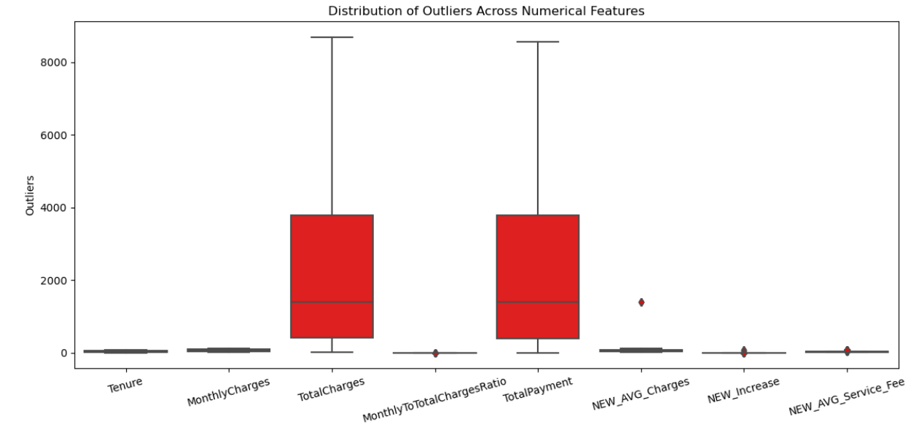
Churn Prediction, Outliers
Outliers, which are data points that significantly differ from the majority of the data in a dataset
Outliers, which are data points that significantly differ from the majority of the data in a dataset

Slide 4
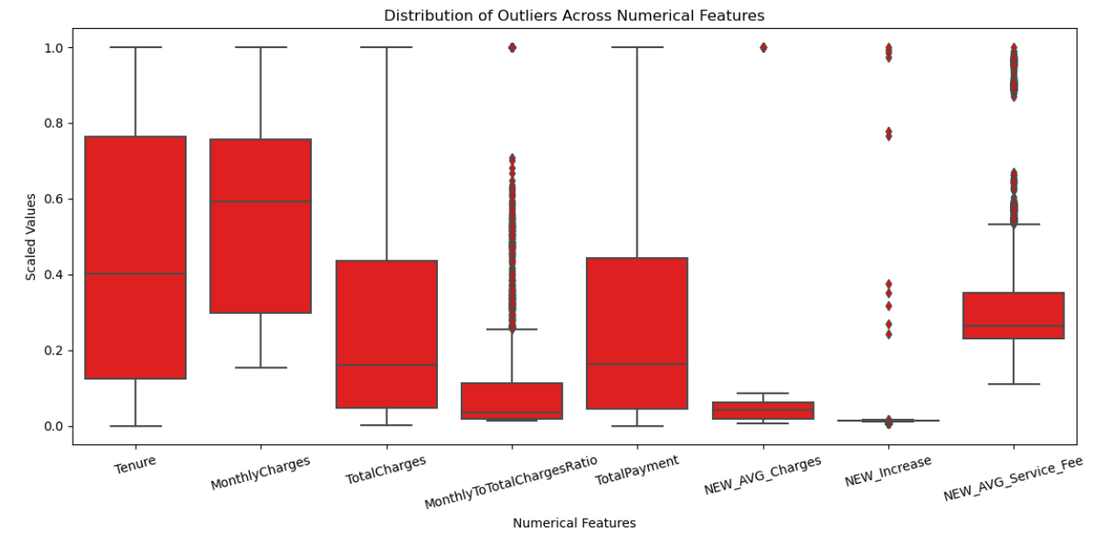
Churn Prediction, Outliers, Normalization(MaxAbsScaler)
MaxAbsScaler is normalize numerical features in a way that each feature's values lie within the range [-1, 1] without shifting the feature's distribution

Slide 5
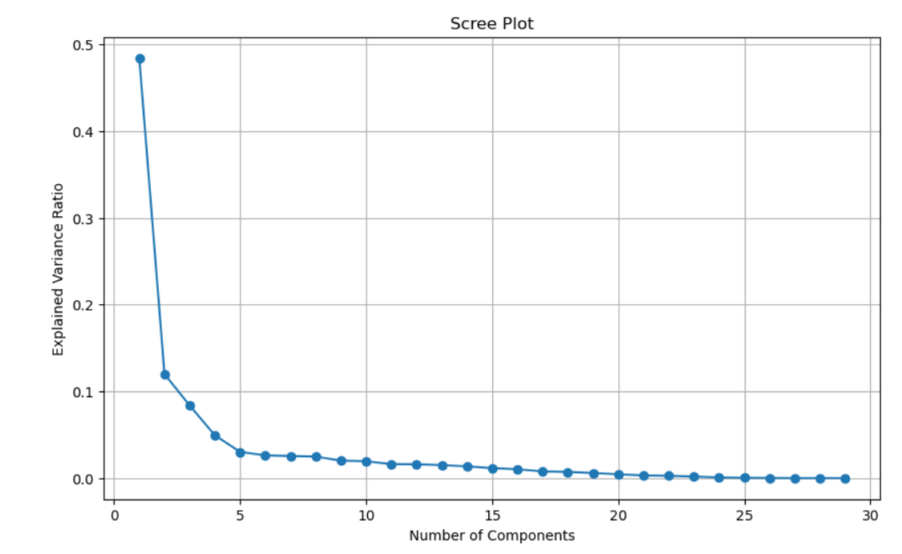
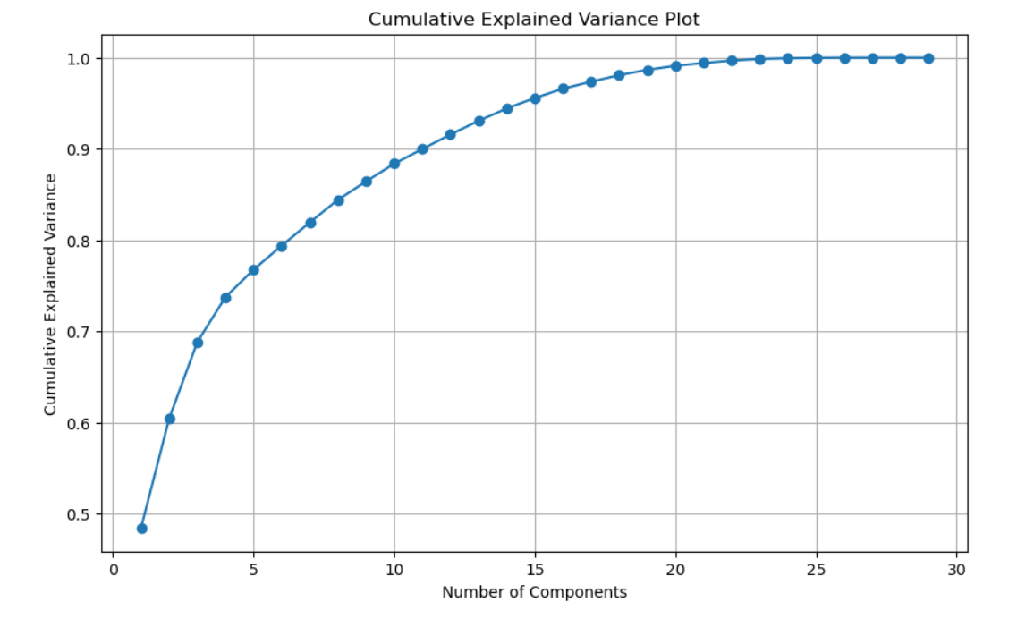
Churn Prediction, PCA, Important Features
We used two techniques for PCA to get the optimal number of features for churn prediction, as shown the below graphs we got a 5 features

Slide 6
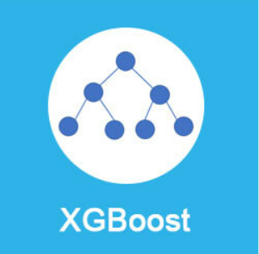
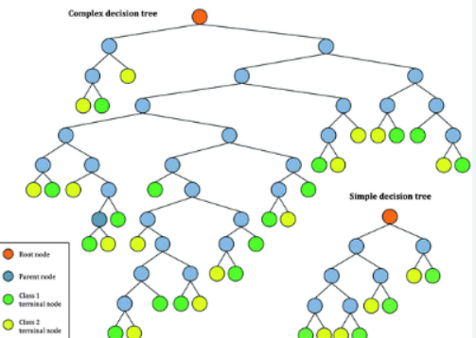
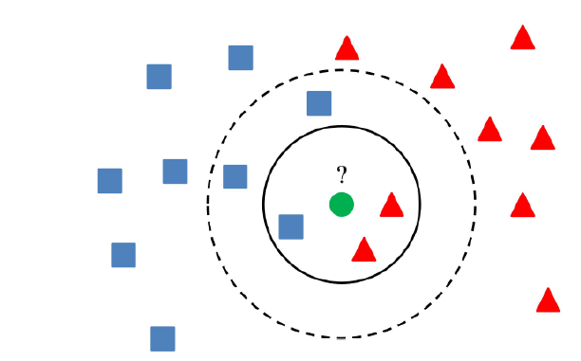
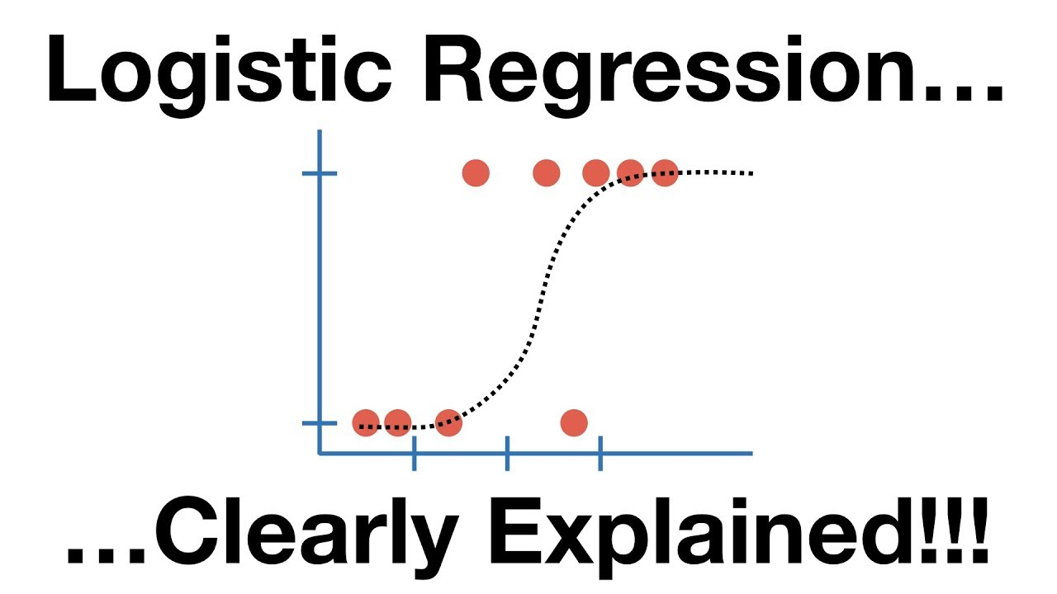
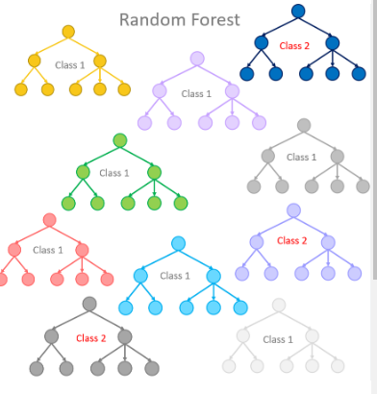
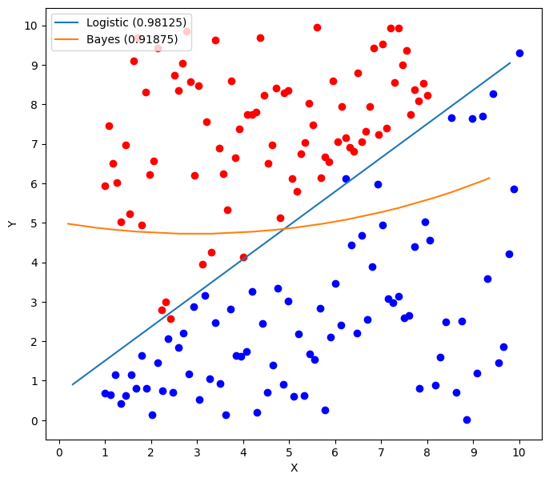
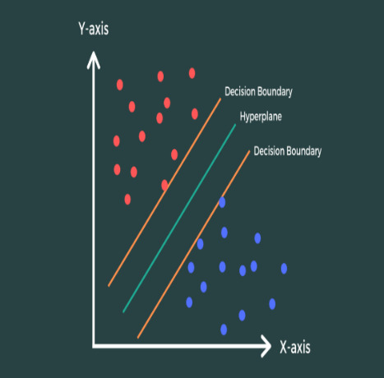
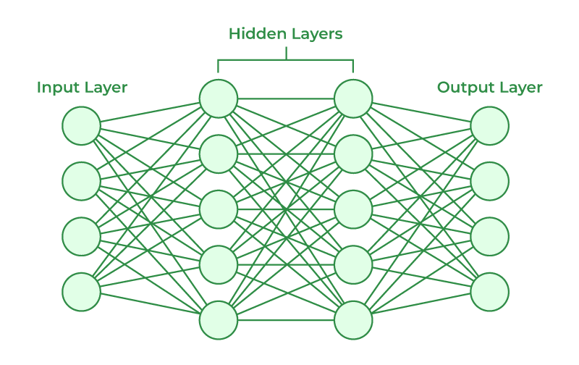
Churn Prediction, Select Model
There are a lot models for classification supervised ML, we are using these models:
XGBoost
CART
Kneighbors Classifier
Logistic Regression
NN
Random Forest
Gaussian NB
SVM

Slide 7
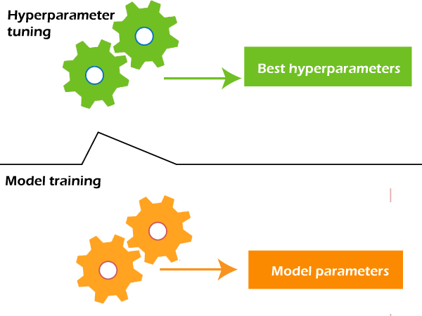
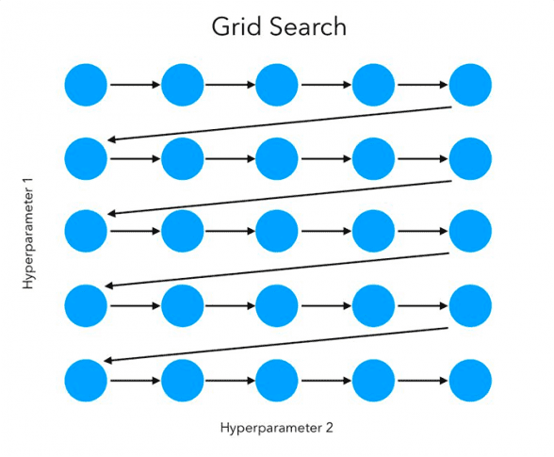
Churn Prediction, Grid Search and Hyperparameters
Grid Search is a technique used in machine learning to find the best combination of hyperparameter values for a given model. In our project we used RandomizedSearchCV

Slide 8
Churn Prediction, Select Model & Evaluation 1
ML Model | Accuracy before any normalization or PCA | Accuracy after normalization and PCA
Perceptron | 77.36% | 70.84%
Logistic Regression | 81.05% | 87.22%
Random Forest | 79.49% | 91.13%
CART | 74.02% | 87.8%
XGBOOT | 80.70% | 90.13%
NN | 76.93% | 88.43%
KNN | 68.20% | 81.05%
Naïve base | 77.71 | 89.9%
SVM | 77.36% | 70.84%
Best hyper parameters for random forest by using grid search | 'n_estimators': 300, 'min_samples_split': 2, 'min_samples_leaf': 1, 'max_features': 'sqrt', 'max_depth': 30, 'bootstrap': False
NN in Deep learning by using Relu and sigmoid functions | 92.3%

Slide 9
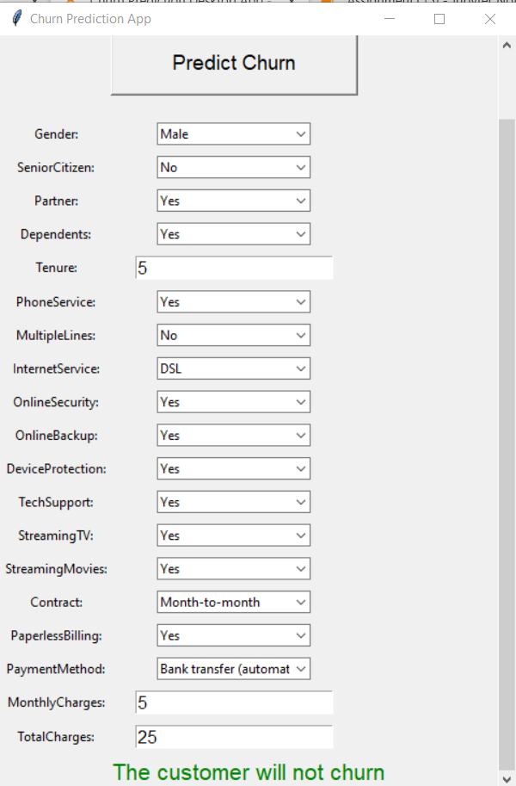

Churn Prediction, Desktop app
The Churn Prediction App is designed to help users predict whether a customer will churn.
It based on various input features
It serves as a user-friendly interface for running predictions using a pre-trained machine learning model.

Slide 10
Churn Prediction, Business Recommendations II
Feature Importance Analysis
Regular Model Maintenance
Resource Allocation
Identify High Churn-Risk Customers:
Customer Feedback Integration

